Slide 1
Superstore Sales Dataset For Analysis Using Power BI

Slide 2
Introduction and Data Background
This superstore data set encompass retail businesses of various sizes, ranging from small to large, offering a diverse range of items at competitive prices to both local and global customers. It is essential for store owners to consistently monitor the Key Performance Indicators (KPIs) of their establishments to ensure they can make well-informed business decisions.
The global superstore sales dataset used for this project is publicly available on Kaggle. The data comprises sales data for three product categories: Furniture, Office Supplies, and Technology, which are sold to three types of customers (Consumer, Corporate, and Home Office) across various geographical locations.

Slide 3
Process
I am excited to state that, I took the necessary process in ensuring that this project has passed through the necessary steps and procedure before finally arriving at the final result.
Two common data cleaning tasks are performed on the dataset. The first involves identifying NULL or missing values, while the second entails checking for any duplicated records. Power BI and Excel, both offers built-in features for both of these tasks.

Slide 4
Objectives
There are two main tasks identified when carrying out this project
Task 1: Efficiently clean, transform, and analyze the dataset
Task 2: Uncover valuable and unexpected hidden insights from the data, answering business questions and providing strategic recommendations

Slide 5
Business Questions/ KPIs
Which segment is the bestseller?
What are the Highest selling and Lowest Selling Sub-Category?
How much each sub-category contributes to the sales of superstore?
Who are the Top 10 Customers of the Superstore?
What are the Top 10 States with highest number of orders (highest order count)?

Slide 6
Business Questions/ KPIs
Which region has the highest order count and in which region do we need to grow our Business? (alternative Q: Which region has the highest sales, and which one has the lowest over the year 2015–2018?)
Growth of Superstore sales over the year 2015–2018
What are the top 10 most selling Products?
What is the most preferred Ship Mode?

Slide 7
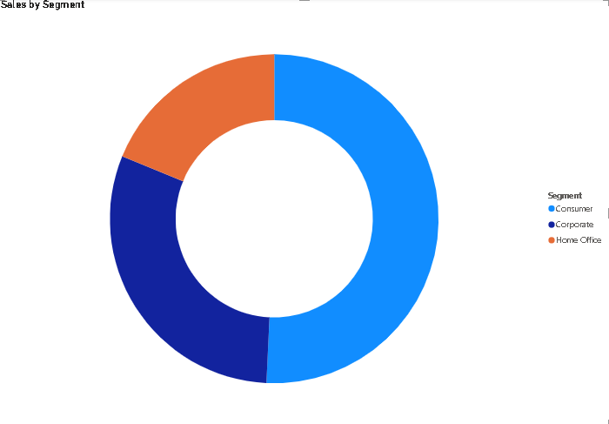
Sales by Segment
Looking at this donut chat it is simply showing that among the three segments, the one making the most sales is consumer segment with total sales amounting to 50.76% of our entire revenue.
This is followed by corporate segment contributing 30.44% to the entire revenue and Home Service segment also contributing a significant 18.79% to the entire total revenue.
This shows that the consumer segment is having something good going on and that more focus should be given in order to make more sales in that particular segment.
Also, focus should be given to Home service segment if management would like to gain more revenue from that segment.

Slide 8
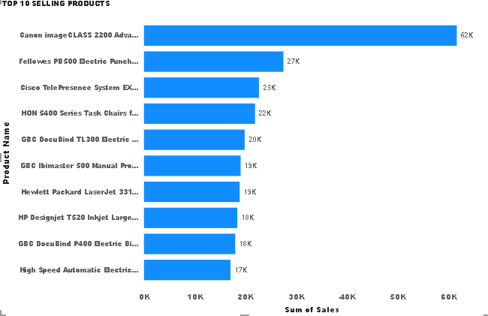
Top 5 Selling Sub-Category
The stacked column chart highlights the top 5 selling sub-category products management should focus on to make the most revenue from. Especially the top 2 products being phones and chairs. Clearly there isn’t significant difference in sales between these two sub-category products especially. So, even though the remaining 3 sub-category products are doing amazing a keen eye must be on these two.

Slide 9
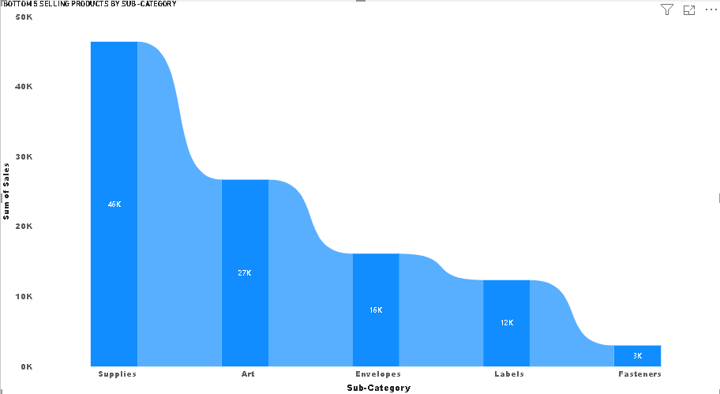
Bottom 5 Selling Products by Sub-Category
From the ribbon chart, we can tell the 5 bottom selling products by sub-category with fasteners being the sub-category providing the least sales altogether, with labels following closing behind along with envelopes.
This shows that management should come up with measures and policies to drive real sales and revenue from these sub-categories if it’s something they are interested in or shut these sub-category products down and focus more on the top selling sub-category products.

Slide 10
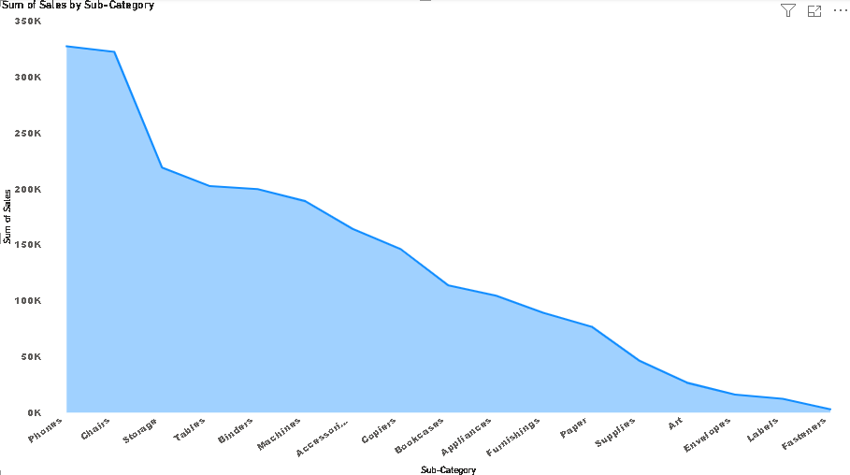
How much each sub-category contributes to superstore
The area chart shows which sub-category is contributing more to superstore and which is contributing less.
As seen, the highest sub-category contributing to superstore is Phones, contributing a total of 327,782.45 USD to superstore whiles, the lowest sub-category been fasteners contributes a total of 3001.96 to superstore.

Slide 11
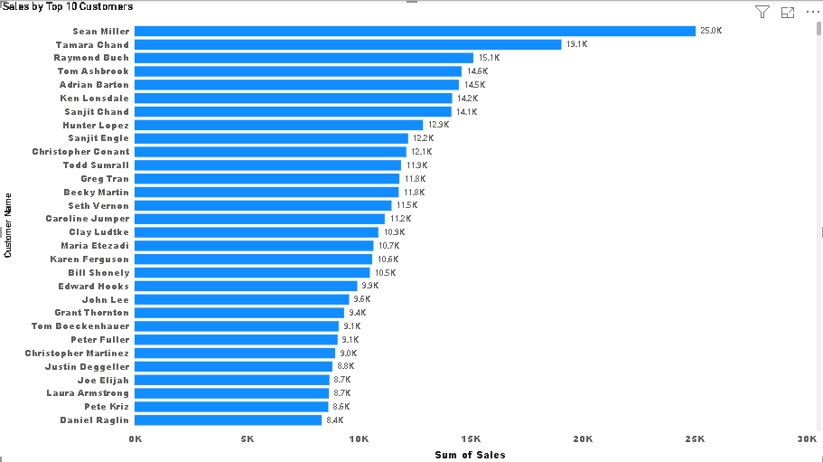
Top 10 customers
Well, looking at this chart, we can see that there really is no significant difference between the top 10 customers in terms of how much revenue that is generated from them.
As a result, the company should try and strengthen their relationship with all of them in order to win their loyalty and retention. This will help the company increase revenue even more.

Slide 12
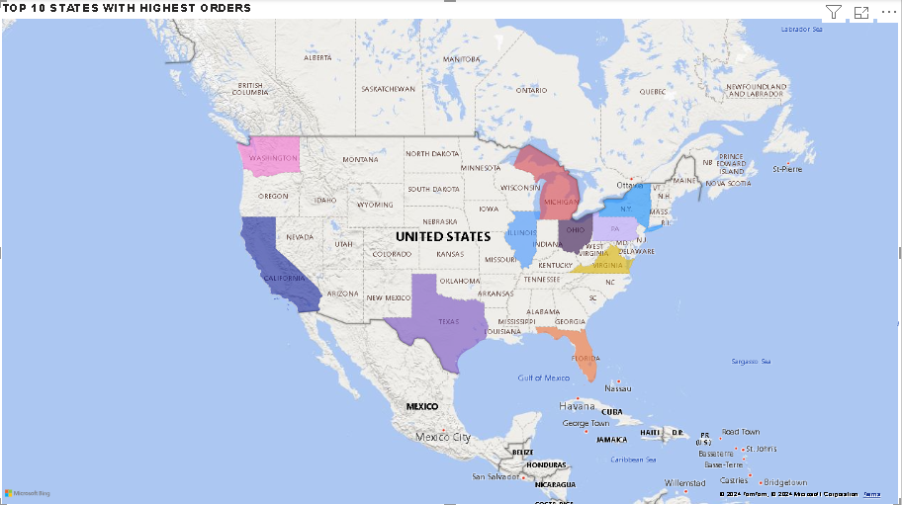
Top 10 States with Highest Orders
This map chart shows that the majority of Orders revenue is generated from Texas, then California followed by Washington and Michigan and so forth.
The map chart also shows which states have higher order counts even amongst the top 10 states that management can use in their decision making.

Slide 13
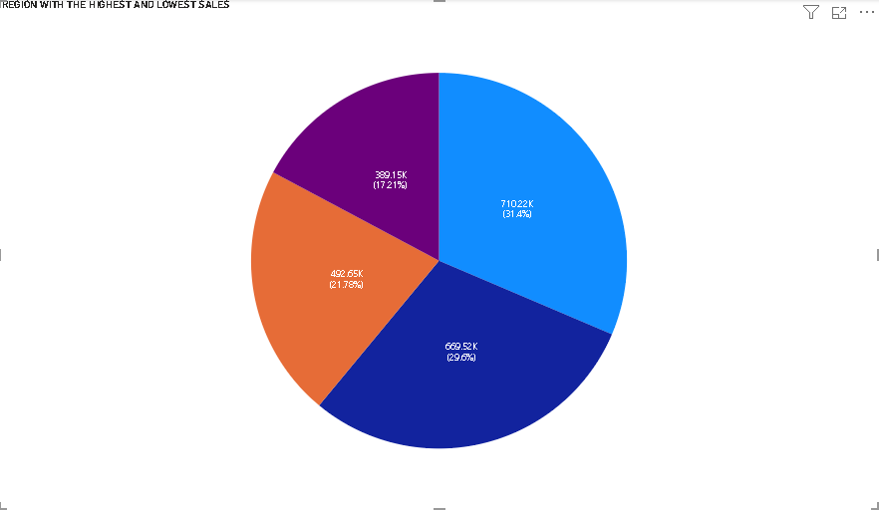
Which Region has the Highest and Lowest Sales
The pie chart shows the various regions and also their sales contributions towards the Superstore.
From the chat, we can deduce the following;
The western region currently contributes the greatest proportion to superstore at an amount of 710,219.68 USD representing 31.4% followed by East which also contributes a total of 669,518.73 USD representing 29.6%, followed by Central contributing a total of 492646.91 USD representing 21.78% and the lowest contributing region being South contributing a total of 389151.45 USD representing 17.21% of the total sales to superstore.

Slide 14
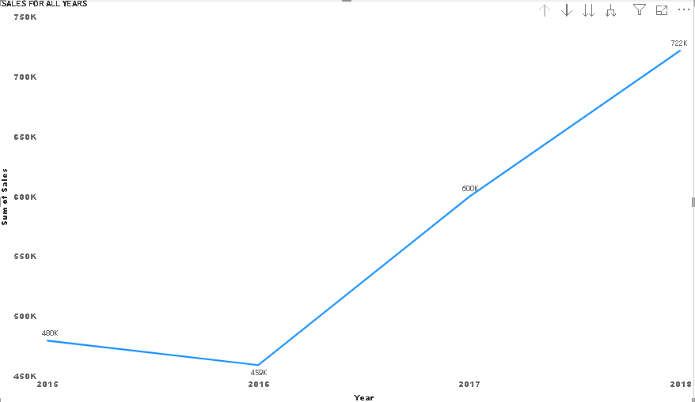
Growth of Superstore sales over the year 2015–2018
This shows that for the first 2 years, total sales or revenue was rather stable with an average revenue of 469,646.11 USD
However, we can see a steady rise in revenue from the third and fourth year.

Slide 15
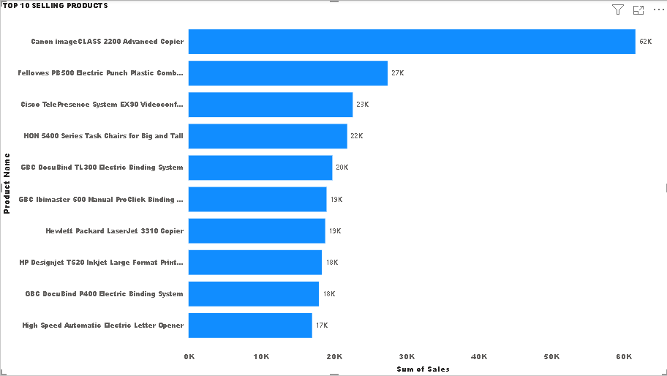
Top 10 Selling Products
This bar chart shows the top 10 selling products for superstore with Canon image glass topping the list with a significant difference at an amount of 61599.82 USD. The difference between the second highest product down aren’t as significant as the top 1 as seen per the chart.
In this regard, management can invest heavily in Canon image glass but then spread their investment fairly across the remaining top products.

Slide 16
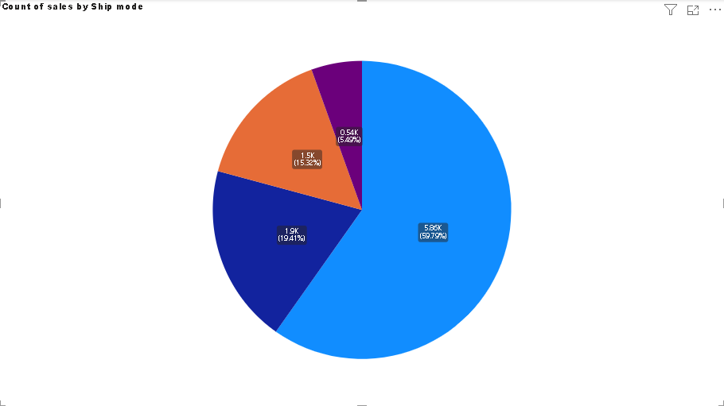
Most Preferred Ship Mode
The pie chart shows the various ship modes per count
From the chat, we can deduce the following;
The standard class currently has the greatest preference in terms of mode of shipping at a total count of 5859 representing 59.79%, followed by second class which also has a total count of 1902 representing 19.41%. followed by first class with a total count of 1501 representing 15.32% and the lowest counting ship mode which is “same day” with a total count of 538 representing 5.49%.

Slide 17
RECOMMENDATIONS
Given that the Consumer segment contributes 50.76% of total revenue, invest additional resources in this segment. Enhance marketing efforts, introduce targeted promotions, and consider expanding the product range to further capitalize on this high-performing segment.
With the Home Service segment contributing 18.79% of total revenue, develop strategies to boost its performance. This could include tailored marketing campaigns, special offers, or improving service delivery to attract more customers and increase revenue from this segment.
While the Corporate segment contributes 30.44% to total revenue, assess current strategies to ensure continued growth. Explore opportunities for deeper engagement or new offerings to maintain or enhance its revenue contribution.
Continuously track the performance of all segments and adjust strategies based on performance data and market trends to optimize revenue across all segments.

Slide 18
RECOMMENDATIONS
Given that Phones and Chairs are the top-selling sub-categories with comparable sales figures, focus on optimizing strategies for these products. Increase inventory, enhance marketing efforts, and consider promotional campaigns specifically for Phones and Chairs to drive further sales.
Continue to support and promote the remaining three high-performing sub-categories. Ensure they receive appropriate visibility and resources to maintain their strong performance while balancing attention with Phones and Chairs.
Keep a close watch on sales trends for Phones and Chairs to quickly identify any shifts in performance or market demand. Adjust strategies as needed to stay competitive and maximize revenue.
Action: Regularly assess the effectiveness of your marketing and sales strategies for these key sub-categories. Use data-driven insights to refine approaches and optimize revenue generation.
By focusing on these high-impact sub-categories while maintaining support for other strong performers, management can effectively drive revenue growth and ensure a well-rounded product strategy.

Slide 19
RECOMMENDATIONS
For sub-categories such as Fasteners, Labels, and Envelopes, develop targeted strategies to boost sales. This could include revising pricing, enhancing product features, or launching marketing campaigns aimed at increasing their appeal.
Conduct a thorough analysis to understand why these sub-categories are underperforming. Gather customer feedback and market data to identify potential gaps or issues that may be affecting sales.
If after evaluation, the low-performing sub-categories do not show potential for improvement, consider discontinuing these products. Redirect focus and resources to support and expand top-selling sub-categories that are more profitable.
Increase investment and marketing efforts in the top-selling sub-categories. Ensure that these products are well-stocked and promoted to capitalize on their strong performance and maximize revenue.

Slide 20
RECOMMENDATIONS
Create tailored engagement initiatives for each of the top 10 customers. Personalized offers, exclusive promotions, and targeted communications can help deepen relationships and encourage increased spending.
Introduce a loyalty program that rewards repeat business and strengthens customer retention. Offer incentives such as discounts, rewards points, or special privileges to encourage ongoing loyalty from these high-value customers.
Schedule regular meetings or check-ins with the top 10 customers to understand their needs, gather feedback, and address any concerns. Building a strong rapport through consistent communication can enhance customer satisfaction and loyalty.
Provide exceptional customer support and service to address any issues promptly and effectively. Ensuring a positive experience will help maintain and grow relationships with these key customers.
Continuously track the effectiveness of these strategies and adjust them as needed based on customer feedback and performance data. Regularly review customer engagement metrics to ensure ongoing success.

Slide 21
RECOMMENDATIONS
Prioritize marketing, sales efforts, and resource allocation in Texas and California, which generate the highest order revenue. Develop targeted campaigns, localized promotions, and strategic partnerships to further boost sales in these states.
Analyze market potential and customer preferences in Washington and Michigan. Implement initiatives to increase order volumes, such as special offers, enhanced customer engagement, or expanded product lines tailored to these states.
Leverage data on order counts from the top 10 states to identify trends and opportunities. Consider expanding successful strategies from high-order count states to other regions with similar characteristics.
Create customized business strategies for each top state based on their order revenue and count. Adjust marketing messages, sales tactics, and distribution plans to align with the unique needs and preferences of customers in each state.
Continuously track performance metrics and customer feedback across all states. Be prepared to adapt strategies based on changes in order patterns and market conditions to maintain and grow revenue.

Slide 22
RECOMMENDATIONS
Invest more in Texas and California, the top revenue-generating states. Increase marketing efforts, allocate additional resources, and explore partnerships to drive even higher sales in these key markets.
Analyze states with high order counts to identify growth opportunities. Tailor marketing and sales strategies to boost order value and revenue in these states, leveraging successful tactics from Texas and California.
Develop targeted initiatives to increase revenue in Washington and Michigan. This could include localized promotions, enhanced product offerings, and strategic campaigns aimed at growing market share in these regions.
Continuously track performance metrics and adjust strategies based on real-time data. Regularly review sales and order count trends to refine approaches and ensure alignment with market dynamics.
Utilize insights from high-performing states to inform decision-making and replicate successful strategies in other states. Customize approaches based on regional preferences and market conditions to optimize overall performance.

Slide 23
RECOMMENDATIONS
Given that the Western region contributes the highest proportion of sales (31.4%), continue to strengthen efforts in this region. Focus on maintaining high customer satisfaction, exploring further market opportunities, and enhancing promotional activities to sustain and potentially increase this strong performance.
With the Eastern region contributing a substantial 29.6% of sales, invest in targeted marketing and strategic initiatives to bolster performance further. Assess current sales strategies and consider additional promotions or product expansions to capture more market share.
The Central region, contributing 21.78% of total sales, presents an opportunity for growth. Develop targeted campaigns and promotions to increase sales, and analyze regional preferences to better tailor offerings and improve market penetration.
As the Southern region contributes the lowest proportion of sales (17.21%), explore ways to increase its performance. This might include localized marketing efforts, special offers, or expanding product lines to address regional needs and boost sales.
Continuously monitor sales performance across all regions and adjust strategies based on real-time data. Regularly review performance metrics to ensure that efforts are effectively driving sales and making an impact in all regions.

Slide 24
RECOMMENDATIONS
Conduct a thorough analysis to identify the key factors contributing to the revenue increase in the third and fourth years. Understand what strategies, market conditions, or operational changes drove this growth to replicate and enhance these factors.
Develop and implement strategies to sustain the upward revenue trend. Focus on scaling successful initiatives and exploring new opportunities for growth. Consider investing in areas that contributed to the increase, such as marketing, product expansion, or operational improvements.
Use the insights gained from the analysis of the growth period to refine strategic planning. Set ambitious yet achievable revenue goals for the coming years based on the recent growth trajectory and ensure that resources are allocated effectively to support these goals.
Continuously track revenue performance and market conditions. Be prepared to adjust strategies as needed to respond to any changes in the business environment or consumer behavior. Regularly review performance metrics to ensure that growth trends are maintained and optimized.
Identify and document best practices from the successful years. Share these insights across the organization to ensure that successful approaches are adopted and standardized for continued growth.

Slide 25
RECOMMENDATIONS
Given that Canon Image Glass is the top-selling product with a significant revenue lead ($61,599.82), allocate a substantial portion of the investment towards enhancing its market presence. This could include increased marketing efforts, expanded inventory, and promotions to capitalize on its strong performance.
While Canon Image Glass should receive focused investment, also distribute resources and investment fairly across the remaining top-selling products. Ensure that marketing, inventory, and promotional efforts support these products to maintain their performance and drive overall revenue growth.
Conduct a detailed analysis of the top 10 products to understand factors contributing to their success. Use these insights to refine marketing strategies, optimize inventory levels, and improve product offerings for both Canon Image Glass and the other top products.
Continuously track sales performance of both Canon Image Glass and other top products. Be prepared to adjust investment levels and strategies based on sales data and market conditions to ensure continued growth and profitability.
Implement targeted customer engagement initiatives for the top-selling products. This could include personalized marketing, loyalty programs, and special offers to enhance

Slide 26
RECOMMENDATIONS
Given that Standard Class is the most preferred shipping mode, representing 59.79% of the total count, focus on optimizing this shipping option. Ensure that Standard Class remains efficient and cost-effective. Consider investing in improving delivery times and customer experience for this shipping mode to reinforce its popularity.
With Second Class shipping representing 19.41% of orders, explore opportunities to enhance this option. Analyze customer feedback to identify areas for improvement and consider targeted promotions or incentives to increase its appeal and usage.
First Class shipping, accounting for 15.32% of orders, should be reviewed for potential enhancements. Assess whether increasing its attractiveness through faster delivery options or better customer service could boost its usage and meet customer expectations.
Although Same Day shipping has the lowest count (5.49%), evaluate its current performance and market demand. Consider whether investing in this service could capture additional market share, and explore innovative solutions to make Same Day shipping more viable and appealing to customers.
Continuously track the performance and customer satisfaction associated with each shipping mode. Use this data to adjust strategies, optimize operations, and ensure that shipping options align with customer preferences and expectations.

Slide 27
Thank You

